Slide 1
Rajan's fractal generator code (FracMap)
Written in C/C++

Slide 2

The algorithm
CreateFractal(N, Df, K, a)
Start
F = { }
Is i = N?
End
yes
no
F = AddNewMonomer(F,r,Rg);
i++;

Slide 3
The algorithm
AddNewMonomer((F, r, Rg)
Start
F = { (0.0), (0.0), (0.0) }
Is Size(F) = 0?
yes
F = F union { NewRandomMonomer(F[0],2*r) }
no
Is Size(F) = 1?
yes
While( not (m = MonteCarlo(F, MIN_TRIALS, 2*r, Rg)))
no
True
F = F union(m);
Return F;
F = RemoveLastMonomer(F);
F = AddNewMonomer(F, r, Rg);
End

Slide 4
The algorithm
NewRandomMonomer(c, R)
Start
Seed1 = Rand();
Seed2 = Rand();
Return v
End

Slide 5
The algorithm
MonteCarlo(F, T, R, Rg)
Is (m = NULL
Or | calcRg(F) – Rg | <
| calcRg(F_opt) - Rg |)
F_opt = F;
M = NULL;
Start
Is T <= trials ?
yes
yes
While( not noOverlap(F, R / 2) )
no
M = rand_monomer;
F_opt = F;
False
True
Rand_target = Rand_int(0, size(F) -1);
Rand_monomer = NewRandomMonomer(F[rand_target], R);
F = union(F,{Rand_monomer});
Is | calcRg(F_opt) - Rg |
< EPSILON
no
Return False
yes
End
Return m

Slide 6
The algorithm
calcRg(F)
Start
N = Size(F);
Rcm = (0.0, 0.0, 0.0);
Rg_sum = 0;
For each m in F
done
Rcm = Rcm + m
Rcm = (Rcm.x / N,Rcm.y / N,Rcm.z/ N)
For each m in F
Rg_sum = Rg_sum + (m.x – Rcm.x)^2 + (m.y – Rcm.y)^2 + (m.z – Rcm.z)^2
done
Return Rg_sum / N
End

Slide 7
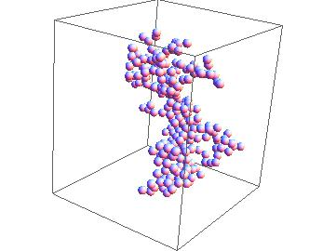
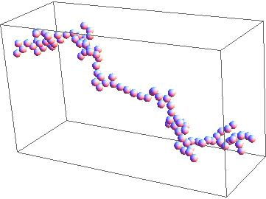
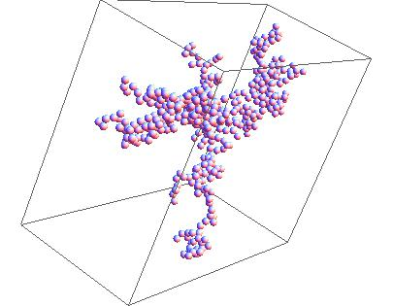
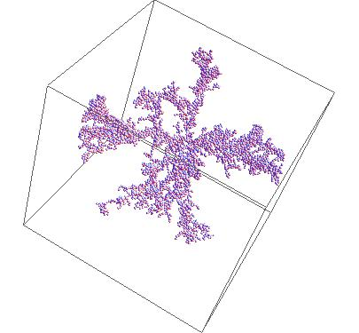
Here are some fractals:
Df = 1.50 , K = 1.0 , N =100
Df =1.82 , K = 2.3 , N = 300
Df = 1.28, K = 8.3, N = 500
Df = 1.90, K = 2.3 , N = 5000

Slide 8
Mishchenko's T-matrix code
Written in FORTRAN

Slide 9
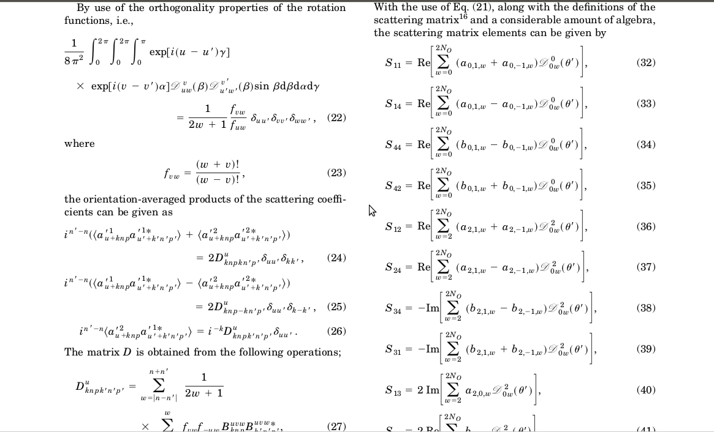
The algorithm
Some of the Math:
A snippet from D. Mackowski and M. Mishchenko's “Calculation of the T-matrix and the scattering
Matrix for ensembles of spheres” 1996

Slide 10

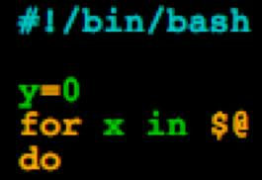
Unix shell scripting
Written in Bash/Script

Slide 11
Shell scripting
  Good automating
  Allows straight forward interaction between the OS and the application

Slide 12

Future Work
GPU Computing (CUDA)

Slide 13
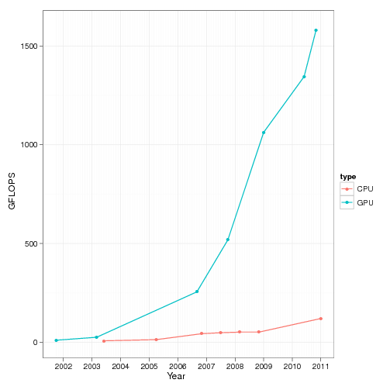
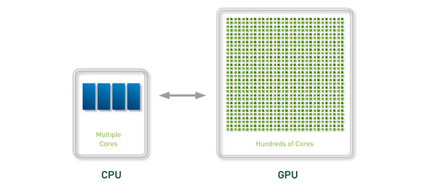
Why GPU computing?
Because its fast.
Taken from www.r-bloggers.com

Slide 14
Questions?

